Slide 1
Ex.6 and QQ plots shenanigans
a presentation by Giovanni Santantonio

Slide 2
1) Generate QQ plots for Sepal Width and Petal Width.
2) Compare them with the QQ plot for Sepal Length and discuss which variable appears
to be the most normally distributed based on the QQ plots.

Slide 3
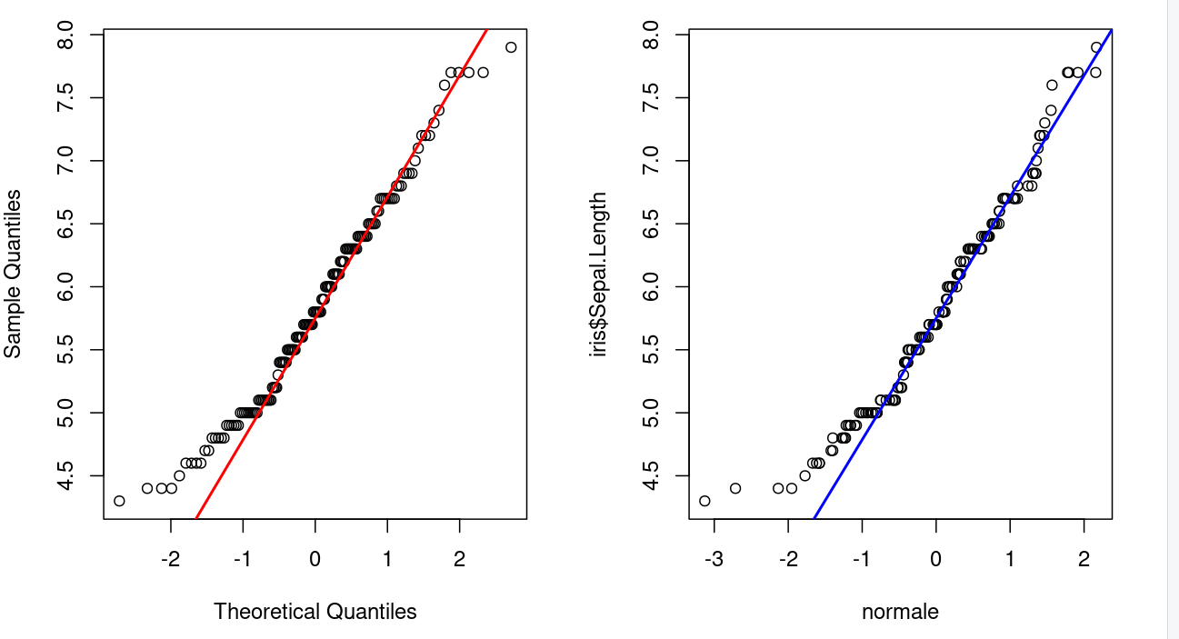
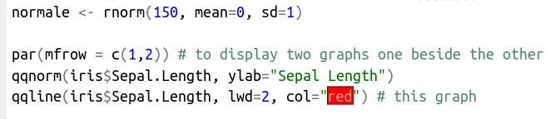
What is a Quantile Quantile plot?
Compares a distribution (y axis) With a normal distribution (x axis)

Slide 4
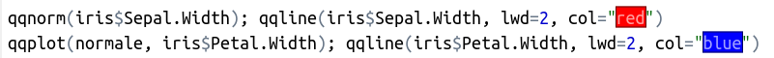
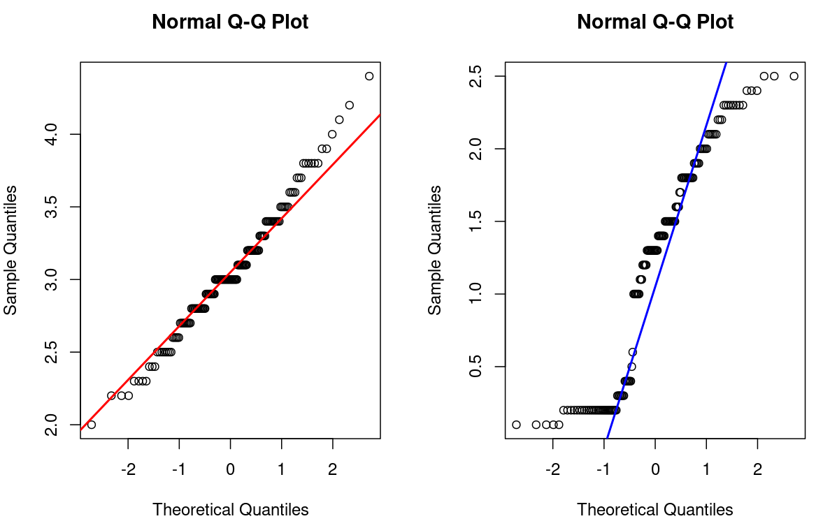

Slide 5

Mumble mumble, what does it mean?

Slide 6
there’s deviation from the line!

Slide 7
Can you guess how their distributions look like?

Slide 8
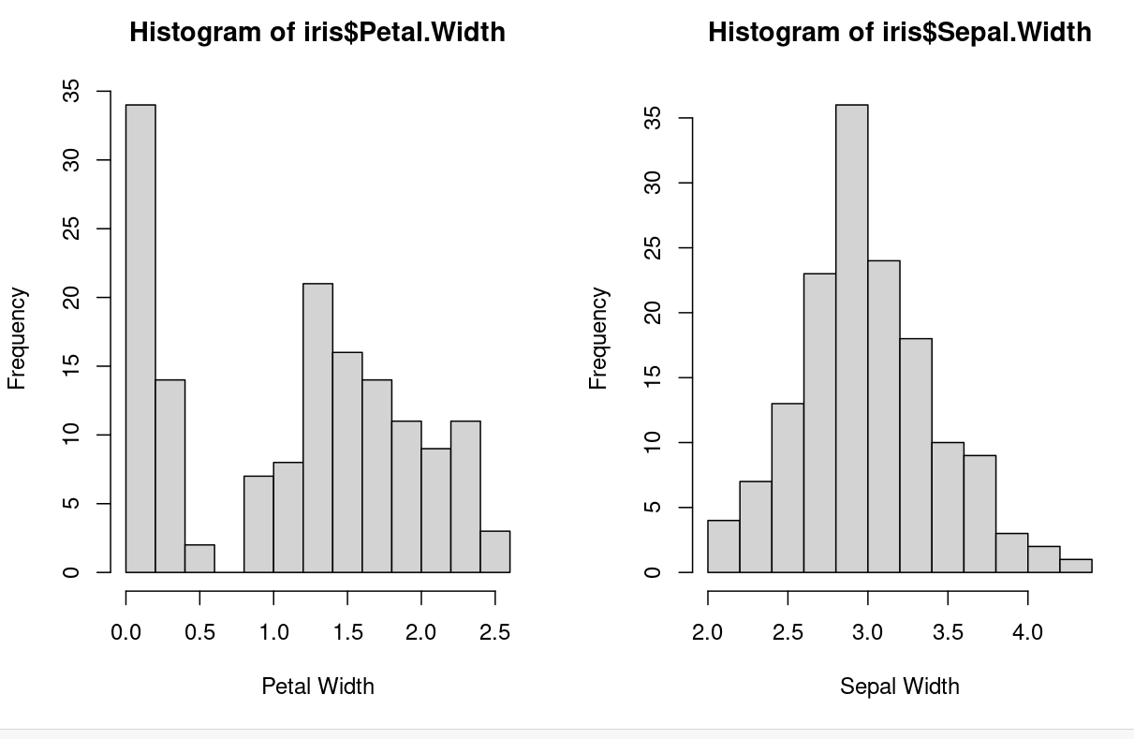
Petal Width is not normally distributed!
Whereas Sepal Width is! We are done.

Slide 9
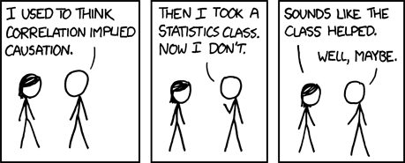
But remember…
Thank you!

